Slide 1

CUSTOMER TRANSACTION ANALYSIS
Insights from Retail_Data_Transaction and Retail_Data_Response
Presented by: Sanket Bhatiya, Data Analytics Intern
Company: Internship Studio
Created on: 03-01-2025

Slide 2
Objective
Analyze customer transactions and responses to understand customer behavior, identify trends, and provide actionable insights for improving customer engagement and revenue generation.
Provide actionable insights for business strategy.

Slide 3
Data Summary
A brief overview of the data columns of both the excel files:
Customer_ID:
Unique identifier for each customer, used to distinguish individual transactions.
Transaction Date:
The date of each transaction, enabling time-based trend analysis and seasonality checks.
Transaction Amount:
The monetary value of each transaction, essential for analyzing revenue patterns and identifying high- value customers.
Response:
Feedback or actions from customers, which can indicate satisfaction, loyalty, or campaign effectiveness.

Slide 4
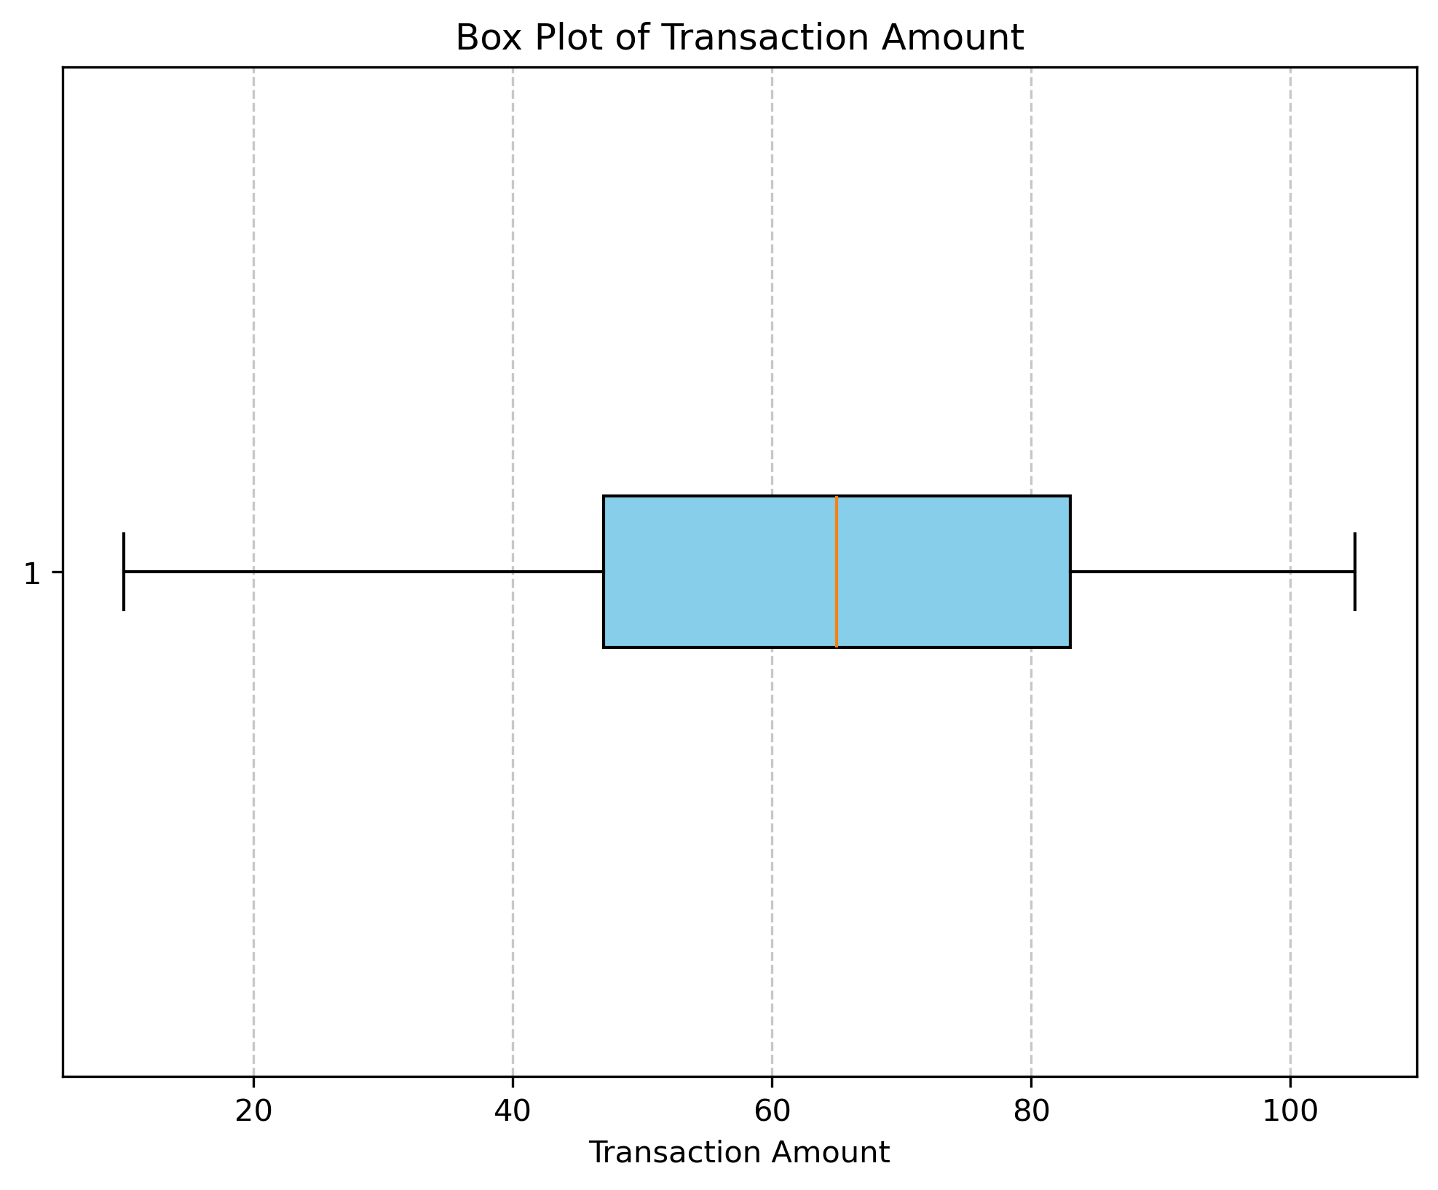
Outliers
Checking of outliers in the dataset:
Box Plot Insights:
- No outliers identified in the dataset.
- Majority of data falls within the interquartile range:
> Lower Quartile (Q1): 47
> Upper Quartile (Q3): 83
Key Statistics:
- Mean (Average) Transaction Amount: 64.99
- Minimum Transaction Amount: 10
- Maximum Transaction Amount: 105
Conclusion:
- The dataset is consistent and reliable.
- Ready to proceed with identifying findings and trends.

Slide 5
Key Metrics
Important key metrics that are calculated from the data:
Total Metrics
Total Revenue | Customer Retention Rate | Peak Transaction Periods
No. of Unique Customers | Monthly Revenue Trends | Customer Segmentation
Average Transaction Value | Response Rate | Top 5 customers (Based on the number of transactions)
Transaction Frequency | High-value Customers | Top 5 customers (Based on highest value of orders)

Slide 6
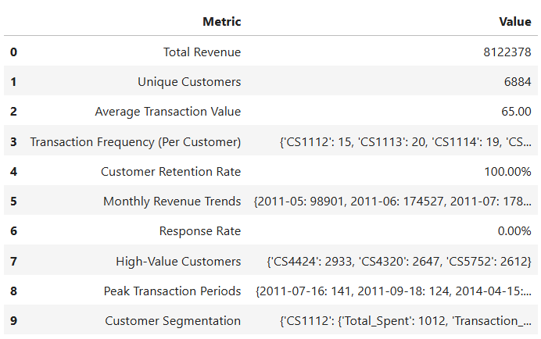
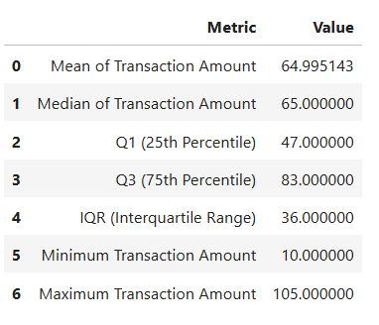
Key Metrics
Visuals of key metric values:

Slide 7
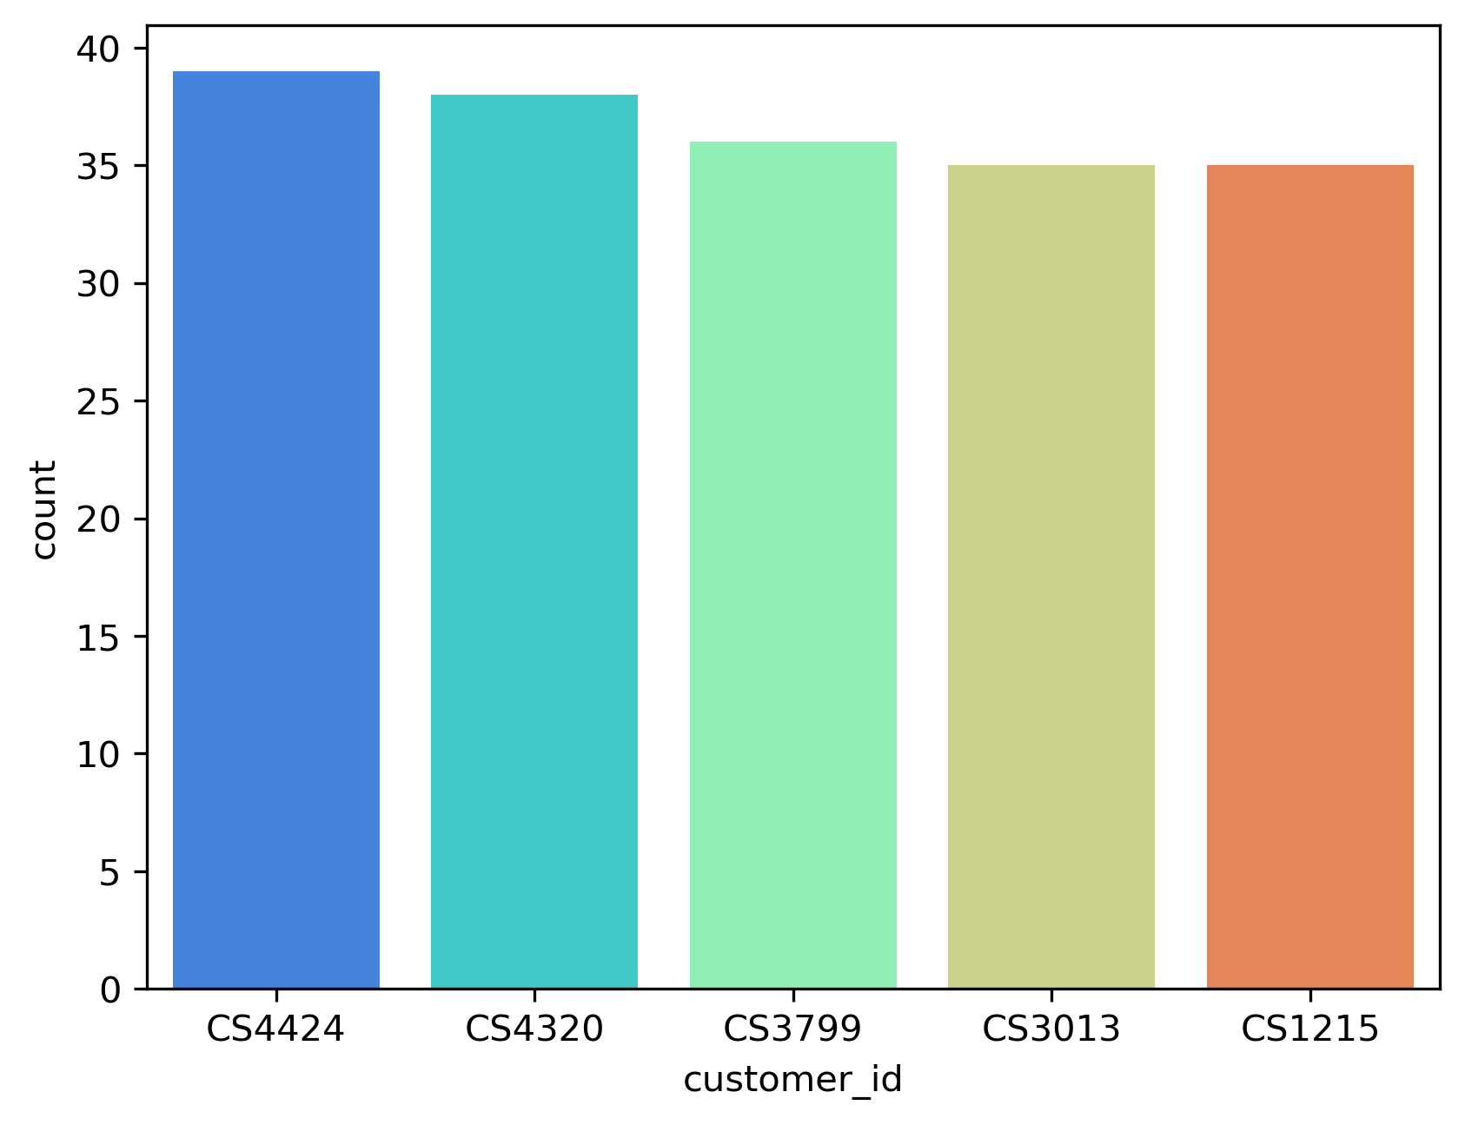
Key Metrics
Top 5 customers (Based on the number of transactions)
Customer_id ‘CS4424’, ‘CS4320’, ‘CS3799’, ‘CS3013’, ‘CS1215’ made a greater number of transactions than the total of 6884 customers.
Where ‘CS4424’ did a highest of ’39’ transactions.

Slide 8
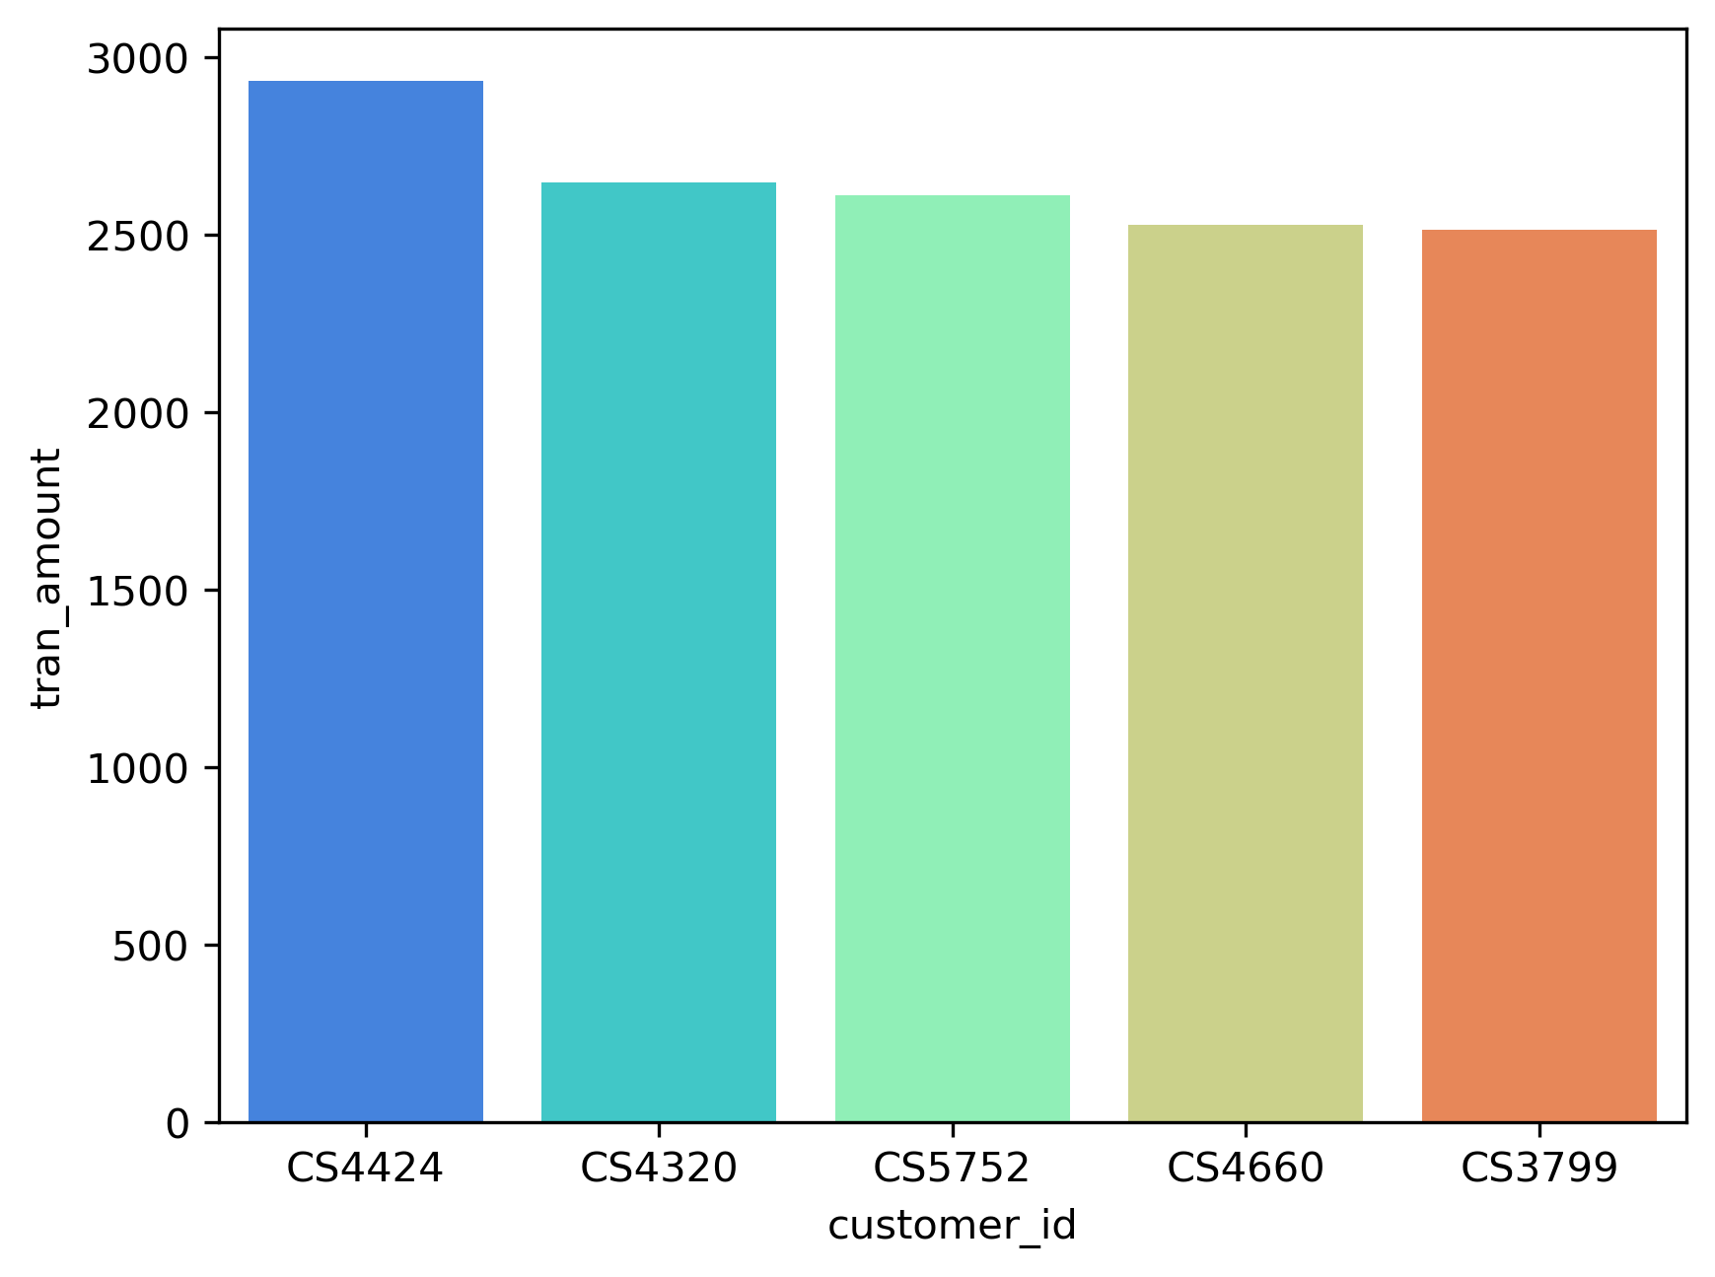
Key Metrics
Top 5 customers (Based on highest value of orders)
Customer_id ‘CS4424’, ‘CS4320’, ‘CS5752’, ‘CS4660’, ‘CS3799’ made highest value of orders than the rest all the customers.
Customer ‘CS4424’ recorded the highest transaction amount of ‘2933’.

Slide 9
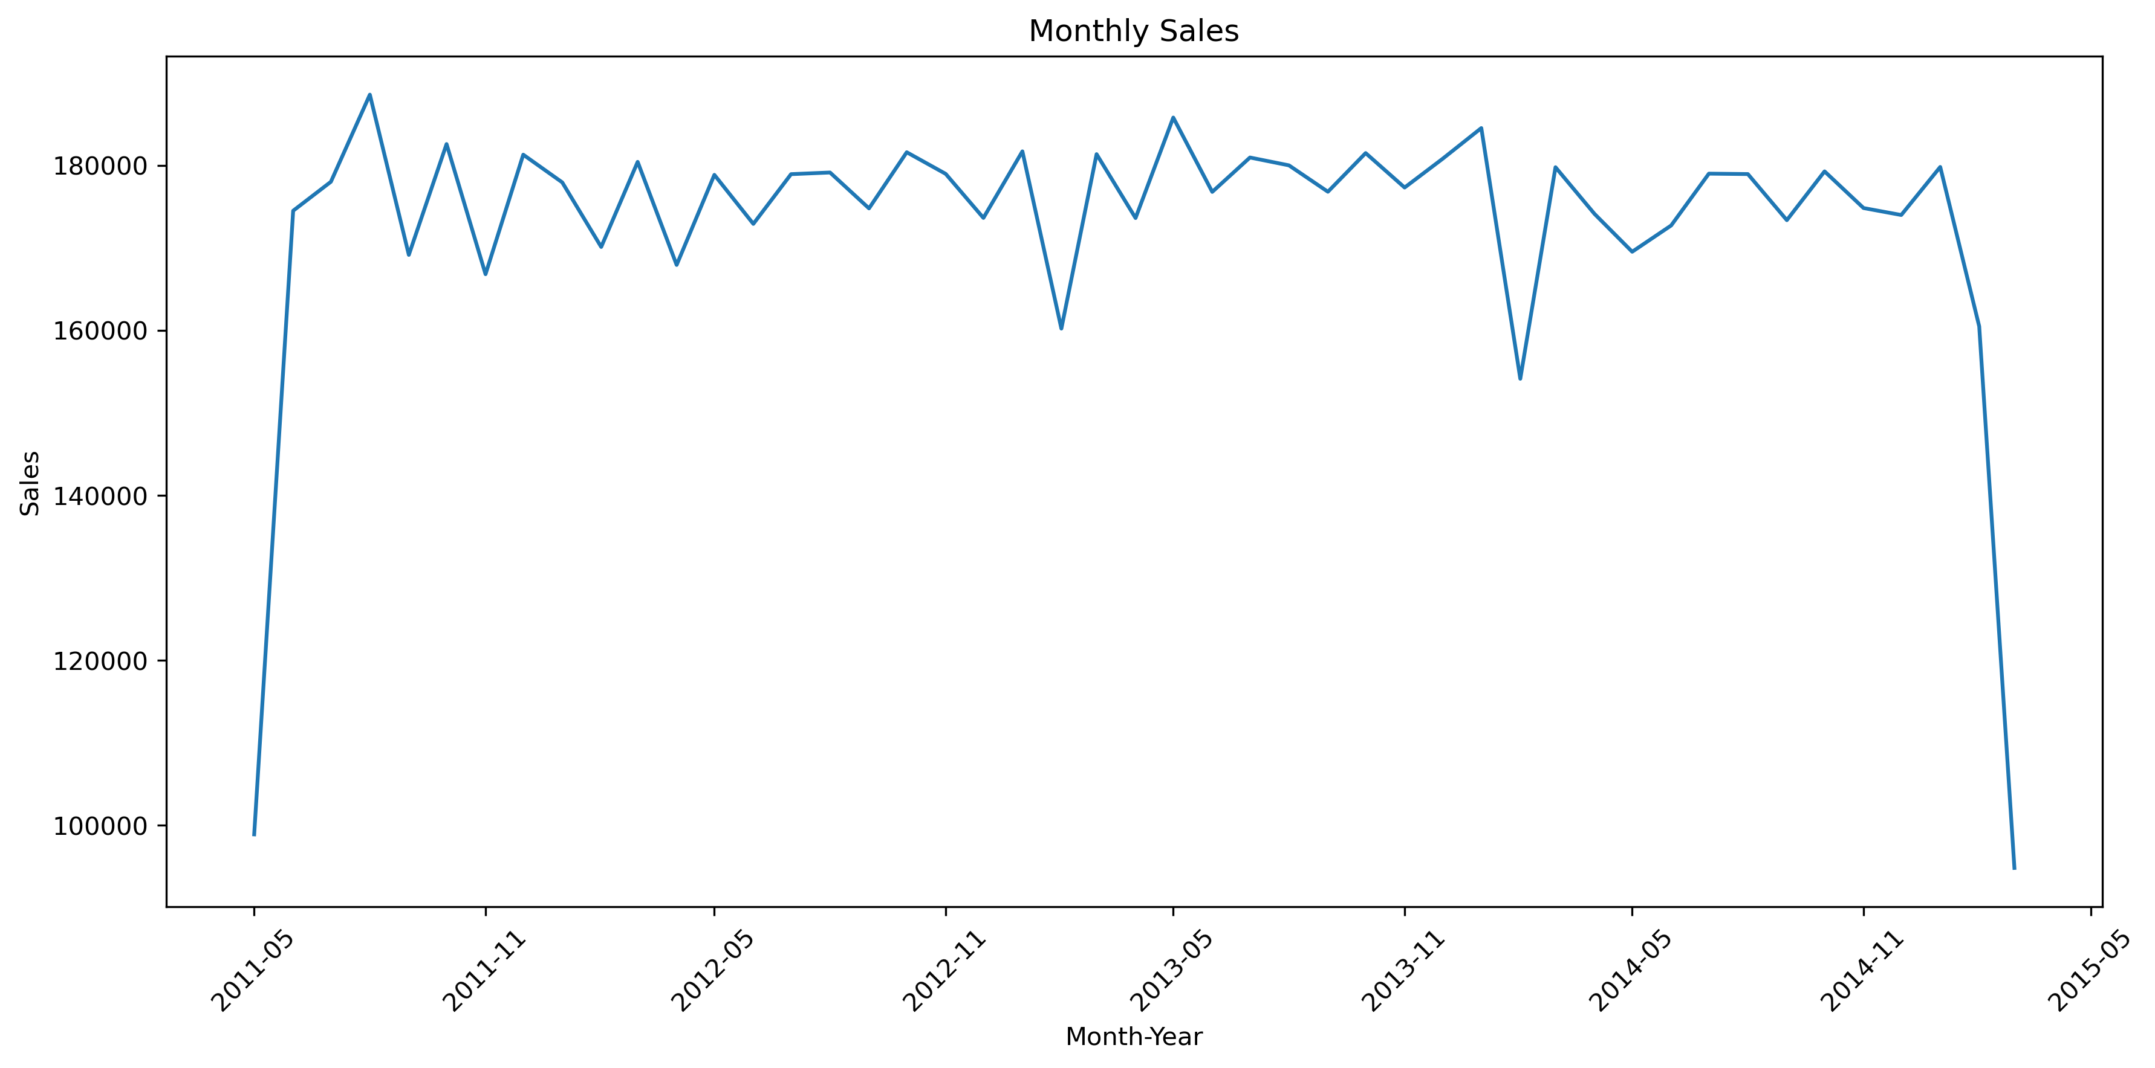
Transaction trends
Sales over time
The Line chart highlights a sales peak after May 2011, reaching the highest selling point.
The first significant drop in sales occurred after November 2012.
The second and lowest sales point was recorded in November 2013, exactly a year later.
Sales consistently show a noticeable decline following the November month of each consecutive year.

Slide 10
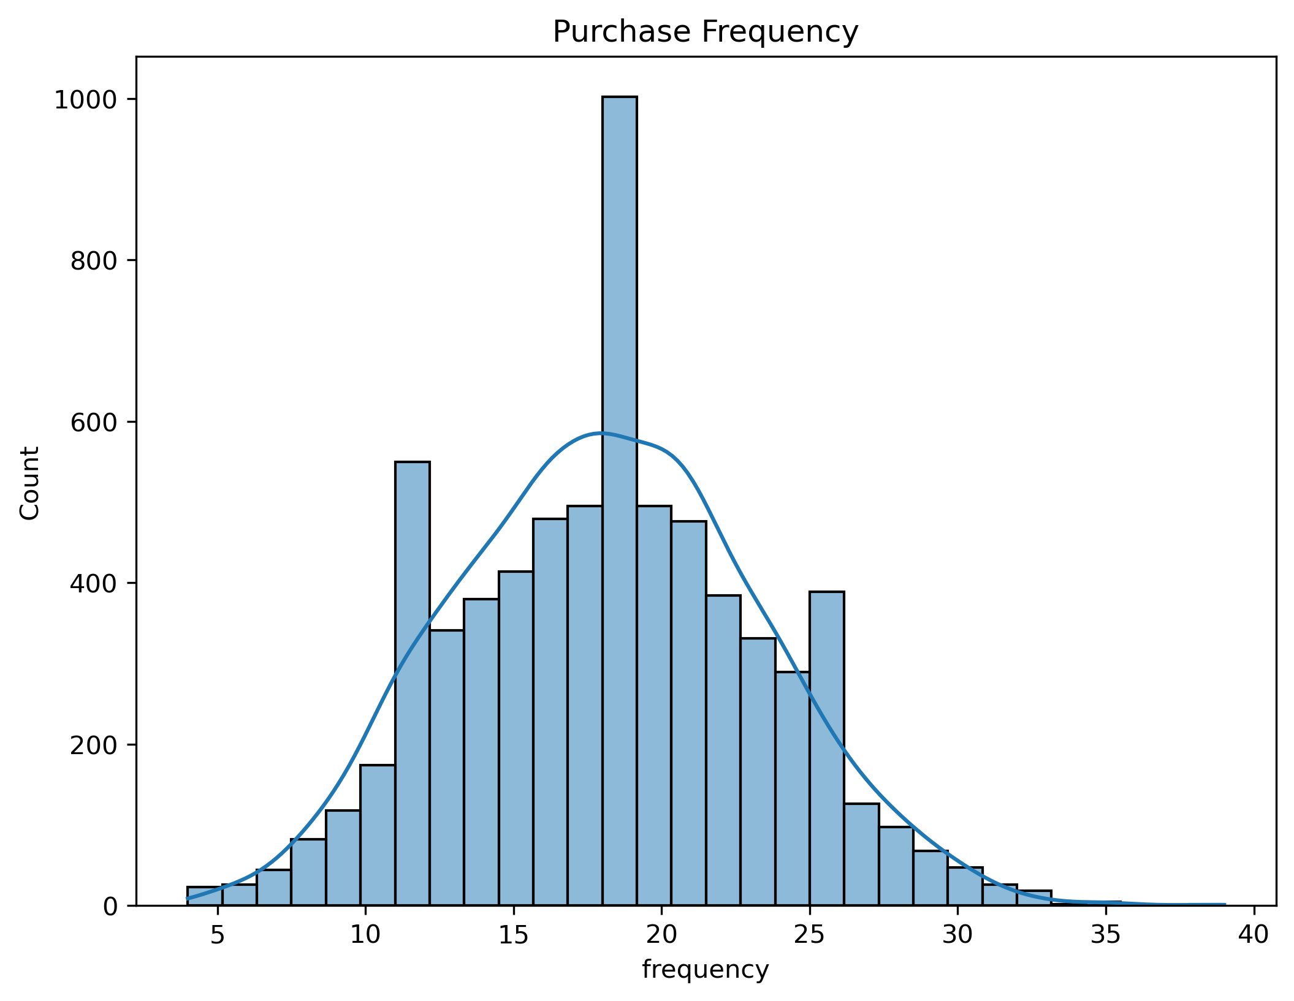
Frequency
Insights from the Histogram Chart
The frequency histogram chart shows the number of times a customer has made a purchase.
Most frequency lies between 16-21.

Slide 11
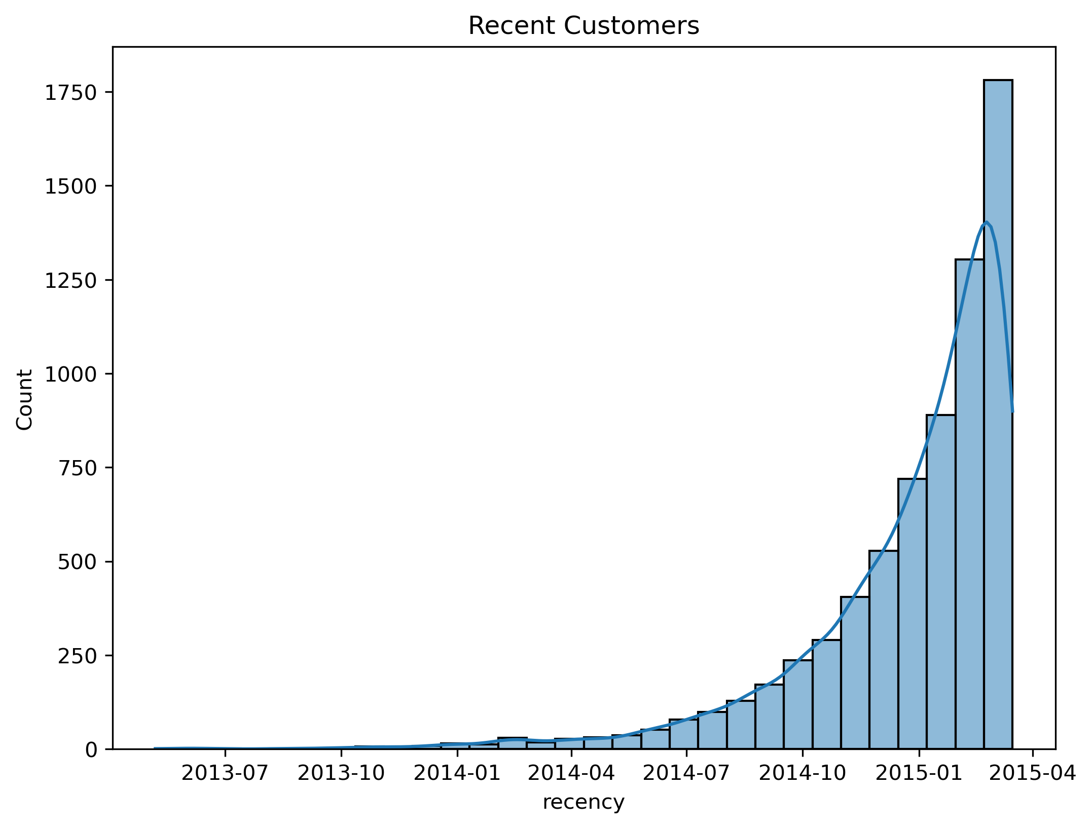
Recency
Insights from the Histogram Chart
The histogram reveals that most customers made their recent purchases after January 2014.
Sales gradually increased, reaching their peak in Frequency 2015.

Slide 12
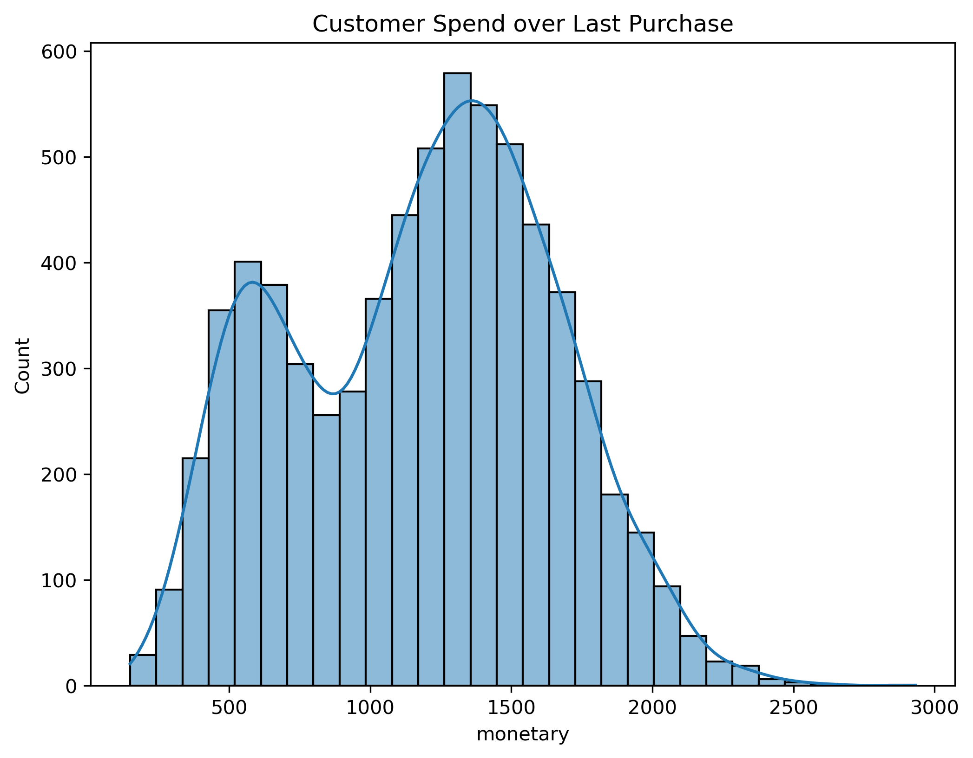
monetary
Monetary Insights
Represents how much a customer spends on purchases.
The histogram reveals an initial small increase in total spending, ranging from 400 to 700 in transaction amounts.
The highest spending peaked within the range of 900 to 2500 in the total transaction amounts.

Slide 13
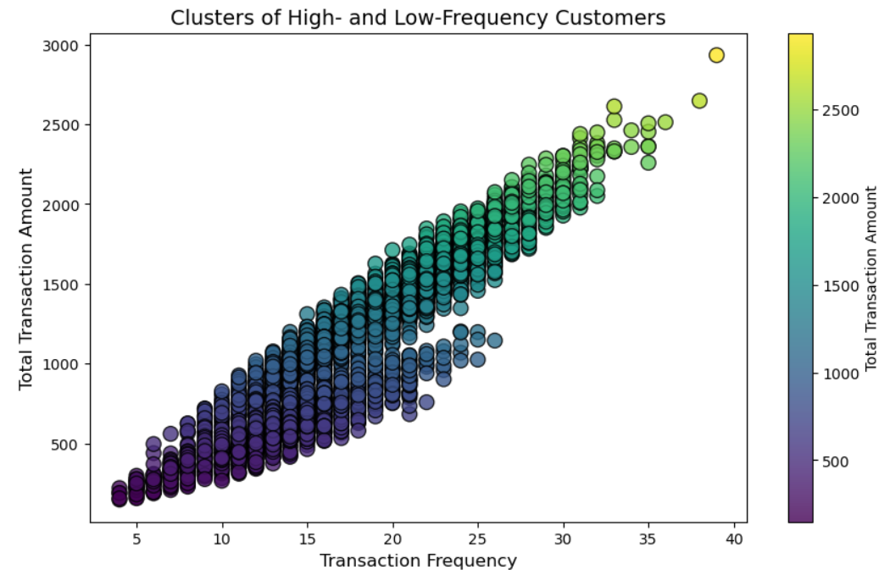
Customer Segmentation
Insights from the Scatter Plot
The scatter plot visualizes the relationship between the no. of purchases made by customers and their total transaction amounts.
Customers with higher purchase frequency generally tend to have greater total transaction amounts.
However, there are exceptions where some high-frequency customers have lower-than-expected total transaction amounts.

Slide 14
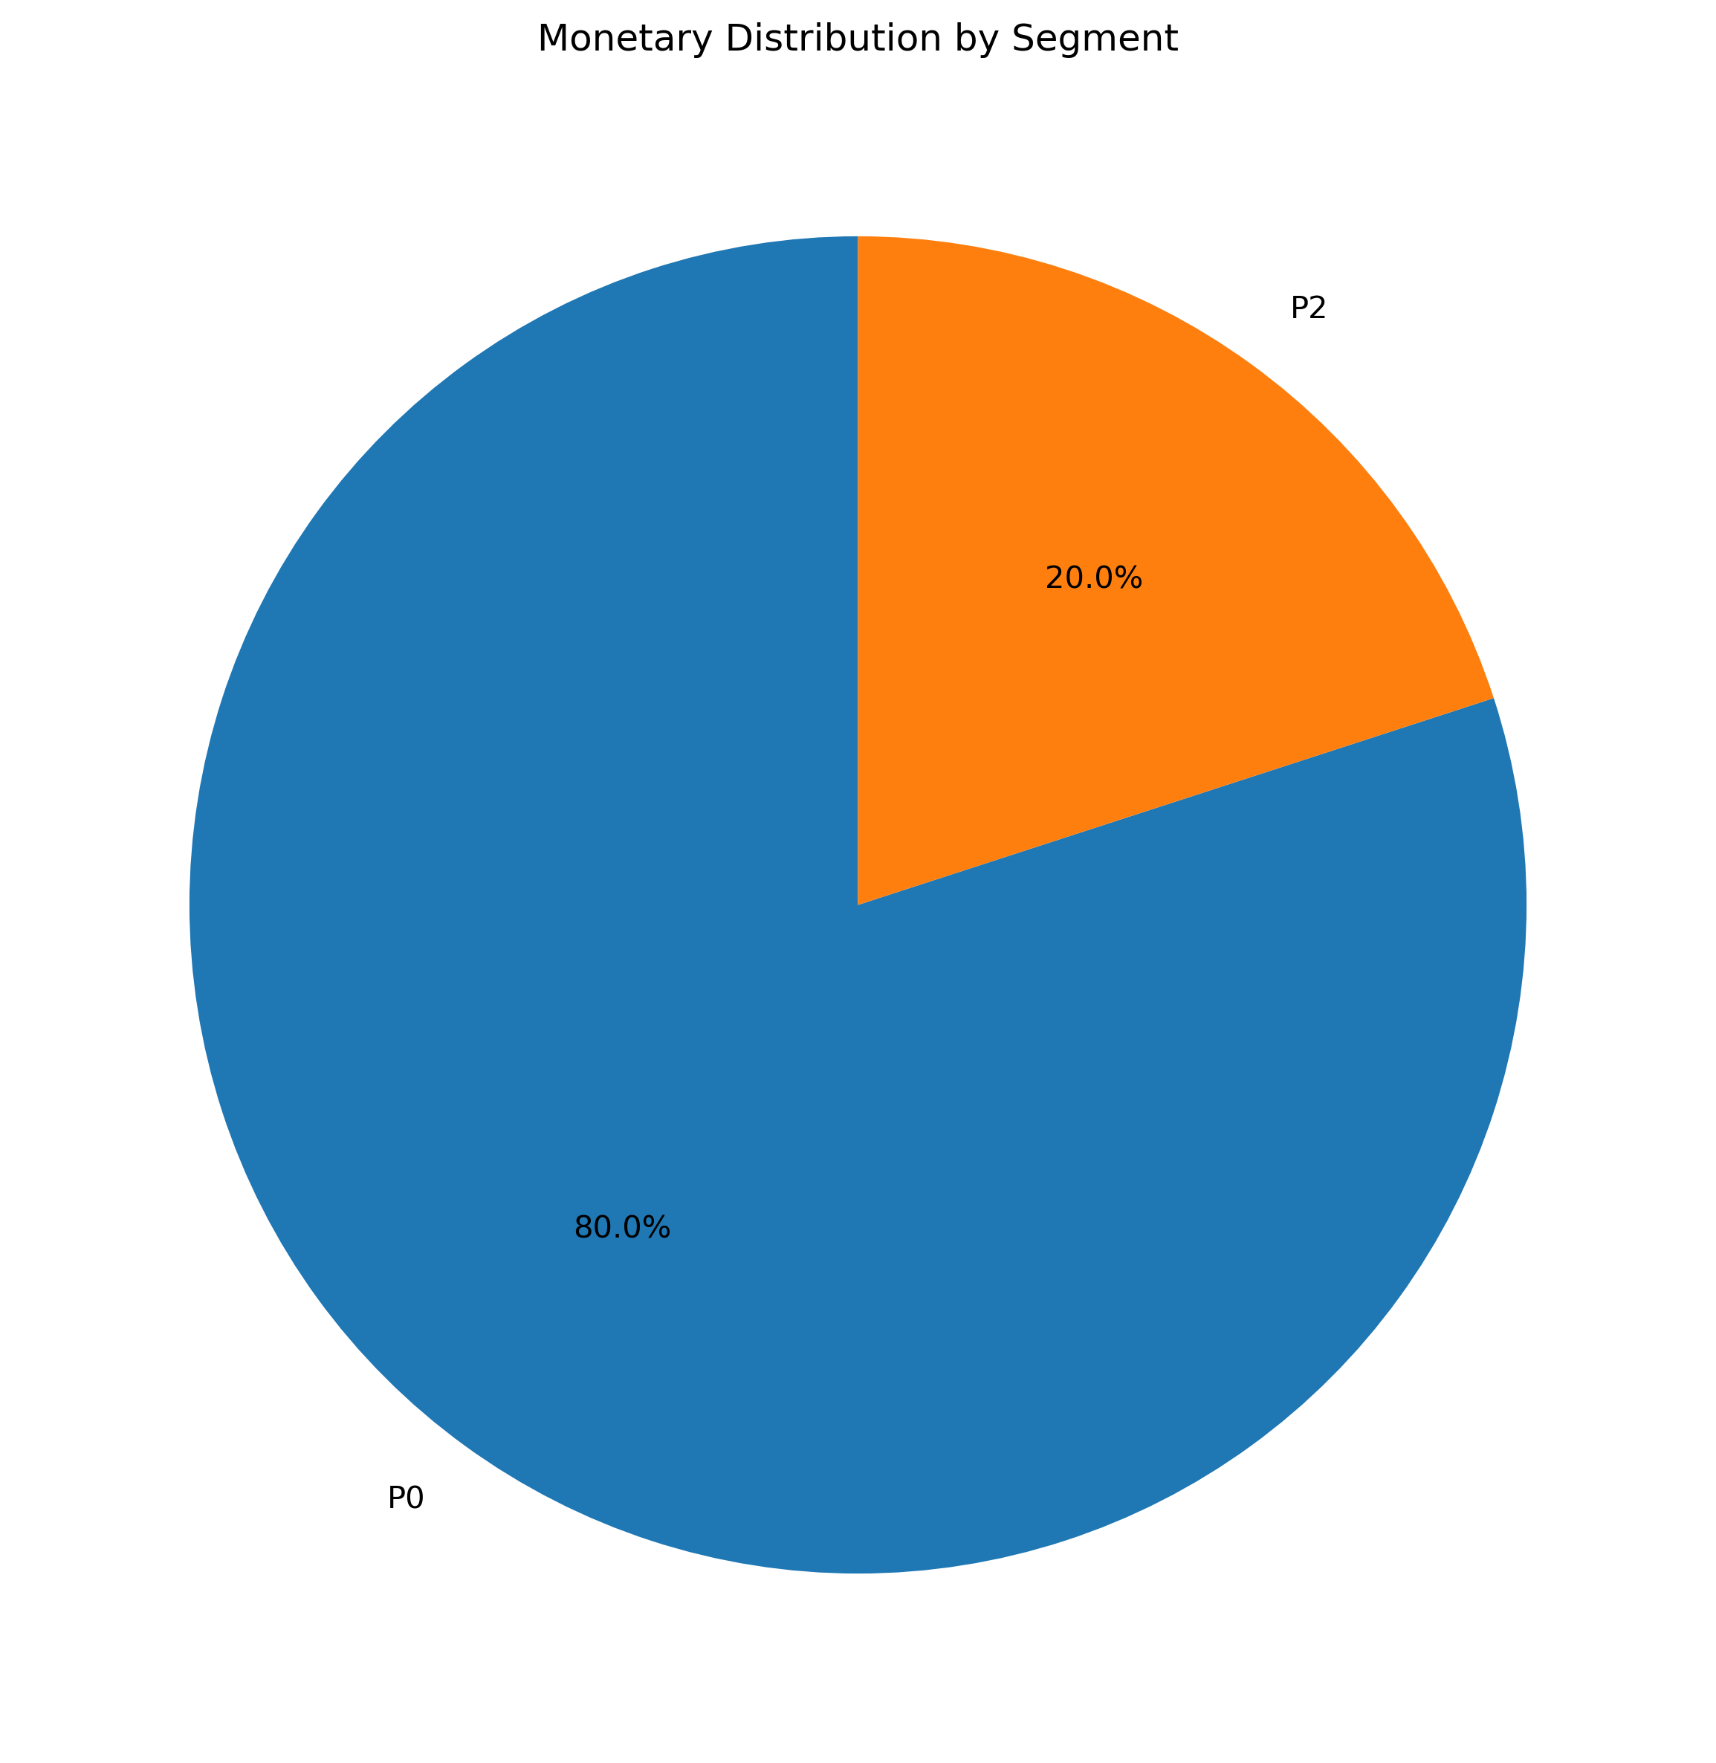
Customer Segmentation
Segmentation by Pie Chart
Here, customers are segmented by two category P0 and P2.
Where;
recency>=2012 ,
P0= frequency>=15,
monetary >1000
recency>=2012 ,
P1= frequency>=15,
monetary >1000
* Recency = How recent a customer's last purchase was (Here, 2012 = Year).
* Frequency = The number of times a customer has made a purchase (Count)
* Monetary = How much money a customer spends on purchases (Amt.)

Slide 15
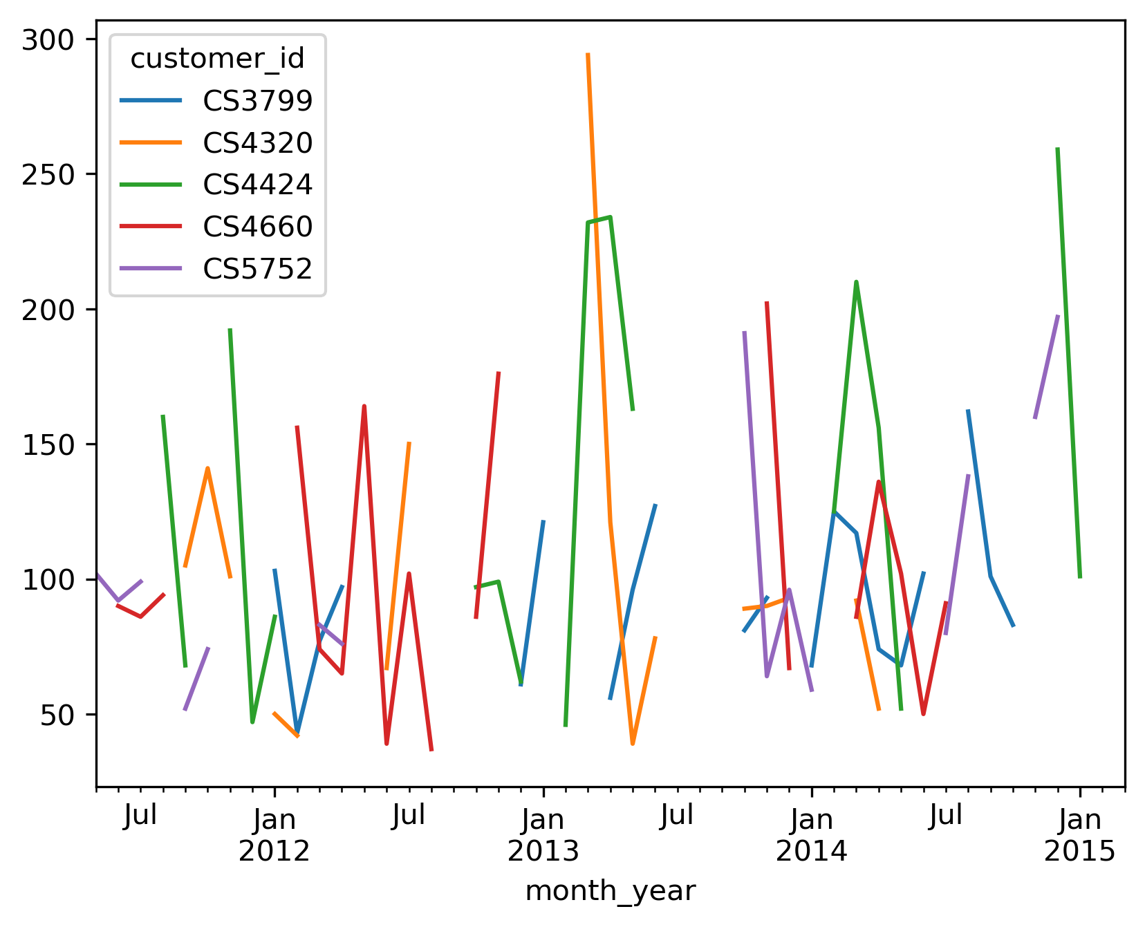
Key Insights
Top Customers over time
The line chart shows the significant purchase of top 5 customers over time.

Slide 16
Key Insights
Time Series Analysis
Consistent Sales:
Sales remained relatively stable between 2011 and 2015, with minor fluctuations.
Significant Drops:
Notable declines in sales occurred around mid-2013 and early 2015, indicating potential issues or off-seasons during these periods.
Initial Surge:
A sharp increase in sales was observed in 2011, suggesting a strong start to the tracking period.
Seasonal Trends:
Sales appear to dip towards the end of each year, suggesting a recurring seasonal pattern or external impact.

Slide 17
Recommendations
Find the reason of Periodic Declines: Analyze the reasons behind significant drops in sales during mid-2013 and early 2015. Address any potential operational, seasonal, or market-related challenges.
Focus on End-of-Year Strategy: Since sales tend to dip towards the end of the year, consider implementing targeted marketing campaigns, discounts, or promotions during these periods to boost revenue.
Enhance Customer Engagement: Engage with customers during the low-sales months offering loyalty program that gives rewards or personalized offers to sustain consistent sales.
Forecast and Prepare for Peaks and Lows: Use historical sales data to predict high and low seasons, and align inventory, resources, and marketing efforts accordingly.
Explore New Revenue Streams: During periods of sales stability, explore potential opportunities for cross-selling, upselling, or introducing new products to maintain growth.

Slide 18
Conclusion
Consistent Sales Performance: Sales remained relatively stable over the years, with noticeable peaks and dips.
Areas for Improvement: Identified key periods (e.g., mid-2013 and early 2015) where sales dropped, indicating potential areas for strategic focus.
Opportunities for Growth: There is an opportunity to target low-performing months and leverage marketing strategies to sustain consistent sales growth.
Next Steps: Implement recommendations to address seasonal fluctuations, customer engagement, and peak season preparation to maximize future performance.

Slide 19
Thank you

